Slide 1
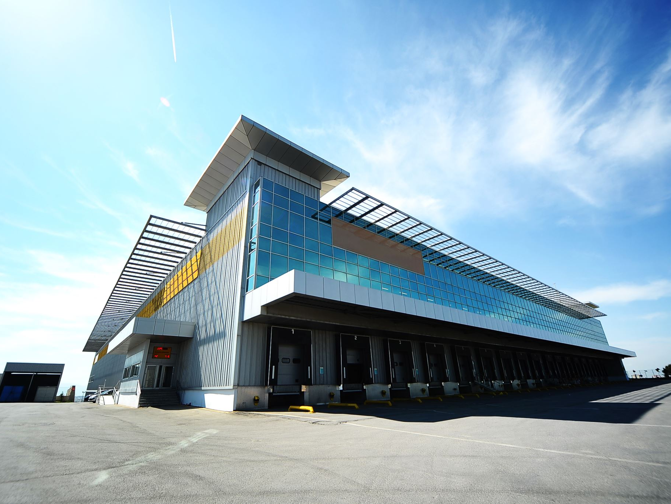
1. MCM-6 Good Housekeeping at Municipal Facilities:
Introduction
Green Country Stormwater Alliance (GCSA)
Employee Training Series
Prepared by INCOG
March 2021
Notes:
This is the first of 6 annotated PowerPoint (aPPT) Training Modules covering the new 2021 OKR04 permit’s required employee training topics under MCM-6.
With GCSA Workshops having to be cancelled, INCOG is substituting physical training meetings with monthly Zoom Meetings and annotated PowerPoint-based materials.
Each aPPT and its Workbook, if available, can be used for local staff training.
The benefit of doing this is that local training can be done at one’s own pace as well as being able to reach more staff.
INCOG will return to physical GCSA Workshop meetings once COVID-19 pandemic health concerns are abated.

Slide 2
Past GCSA Employee Training included group workshops held approximately quarterly.
INCOG had to cancel all GCSA Workshops in 2020 and the first half of 2021 due to COVID.
Monthly Zoom meetings have replaced Workshops as a training substitute.
INCOG also prepares annotated PowerPoints and Workbooks of the Zoom meeting material.
These can be used for local training by GCSA Members.
This 6-part series of MCM-6 training material covers the new 2021 OKR04 MCM-6 Good Housekeeping training requirements.
Changes to GCSA Employee Training Outreach
Notes:
Past GCSA Employee Training focused on GCSA Workshops held approximately quarterly.
INCOG has had to cancel its 2020 and half of 2021 workshops due to COVID. INCOG’s GCSA Training is now via monthly Zoom Meetings for 1.5 to 2 hours each.
Each Zoom Meeting’s PowerPoint is annotated as a aPPT PDF file for local staff training and education use.
The 2015 OKR04 permit’s 6th Minimum Control Measure (MCM-6) has specific topics that must be addressed in staff training.
The 2021 OKR04 permit has re-phrased these passages more generally, but the same topics have been carried over.
The material in this MCM-6 Training has not been presented in a Zoom Meeting yet.

Slide 3
2015 OKR04 MCM-6 Employee Training
OKR04 Part | Training Topics | Notes
IV.C.6.a Good Housekeeping | “…preventing or reducing pollutant runoff from MS4 operations.” | Operation and maintenance program training component with the goal of…
IV.C.6.a(1) Good Housekeeping | “park and open space maintenance” | “…employee training to prevent and reduce stormwater pollution from activities such as…”
 | “fleet and building maintenance”
 | “new construction and land disturbances”
 | “stormwater system maintenance”
IV.C.6.a(2) Good Housekeeping | “prevent and reduce stormwater pollution from MS4 activities.” | “…employee training and education program to…”
Notes:
This table shows the specific employee training topics under MCM-6 in the 2015 OKR04 permit.
Two of these, the requirements in the first and last rows, are general “reducing pollution from” topics that do not list specific types of pollutant-generating activities.
The middle rows list the 4 specific areas required for employee training; these specific topics have been re-phrased in the latest draft of the 2021 OKR04 permit.
Note the use of the terms “MS4 activities” under one passage and “MS4 operations” under another.
For purposes of training topics, INCOG assumes that these 2 terms mean the same thing.
The 2021 OKR04 permit has a specific description of “MS4 Operations” that includes the MS4 collection system itself.

Slide 4
2021 OKR04 MCM-6 Employee Training
OKR04 Part | Training Topics | Notes
V.C.1.a.ii.(5) (MCM-1) | “conduct staff training to prevent and reduce stormwater pollution from MS4 activities.” | An MCM-1 requirement to address MCM-6 training.
V.C.1.a.ii.(5) (MCM-1) | Category 1: train every 2 years Category 2: train once each year Category 3: train once each year | This V.C.1.a.ii.(5) MCM-1 training schedule likely also applies to V.C.6.a MCM-6 training (below).
V.C.6.a (MCM-6) | “…MS4 operations such as streets, roads, highways, parking lots, maintenance and storage yards, fueling areas, waste transfer stations, fleet or maintenance shops, salt/sand storage locations and snow disposal areas.” | MCM-6 includes a training component in the MS4’s Operation and Maintenance program with “the ultimate goal of preventing or reducing pollutant runoff from…”
Notes:
The new 2021 OKR04 permit has re-phrased the 2015 specified MCM-6 training topics, but most are still listed in some fashion.
The 2021 OKR04 permit now defines “MS4 operations” as “streets, roads, highways, parking lots, maintenance and storage yards, fueling areas, waste transfer stations, fleet or maintenance shops, salt/sand storage locations and snow disposal areas.”
Missing are references to “new construction and land disturbances” and “park and open space maintenance”.
However, these missing training topics involve activities under “MS4 operations” as well as “MS4 activities” concept.
The 2021 OKR04 permit now adds Table V-2 showing the frequency of training required under each MCM with MCM-1 now listing most employee training passages.

Slide 5
2015 OKR04 “Employee Training”
DEQ has allowed a variety of MS4 activities as “training”:
  Discussing OKR04 and stormwater issues in staff meetings.
  Stormwater discussions in municipal council / commission meetings.
  Webinars, workshops, classes, courses, documents, etc.
Records must be kept of all such training activities:
  For each employee and for the Annual Report.
  Who, what, where, when…
Notes:
Neither the 2015 nor the 2021 OKR04 permit describes specific types (i.e., methods) of training.
Both permits list topics generally, such as “fleet or maintenance shops”, and the 2021 permit specifies frequency of training by MS4 Category.
Missing are length of training (e.g., hours spent in learning), types of training (online, workbooks, workshops, staff meetings, etc.) and who conducts training.
Over the years, DEQ has encouraged MS4s to record many internal meetings and discussions about stormwater as staff training.
INCOG has hosted GCSA Employee Training Workshops approximately annually or biennially on the OKR04-required Employee Training topics.
Regardless of the training type or venue, MS4s should keep records of attendance, date, topics, venue and duration for their Annual Reports to DEQ.

Slide 6

MCM-6: “Pollution Prevention / Good Housekeeping For MS4 Operations”
2015 OKR04 did not define “MS4 Operations”.
For years, MCM-6 compliance focused on municipal buildings and storage areas.
2021 OKR04 defines “MS4 Operations” as: “MS4 operations such as streets, roads, highways, parking lots, maintenance and storage yards, fueling areas, waste transfer stations, fleet or maintenance shops, salt/sand storage locations and snow disposal areas.”
What Does MCM-6 “Good Housekeeping” Cover?
Notes:
When the OKR04 permit program began in 2005, there was a general agreement that MCM-6 covered mainly structures and storage areas.
These included Public Works buildings and adjacent lots for vehicle and equipment storage and maintenance and other municipal buildings.
Both the 2015 and 2021 OKR04 permits use the terms “MS4 operations” and “MS4 activities”, with the new permit specifically defining “MS4 operations”.
This definition includes “streets, roads, highways, parking lots” as part of the MS4 operations to which MCM-6 applies.
DEQ agrees that, for the inspection frequency requirements in Table V-6, inspections should focus on facilities and storage areas, not the entire MS4 collection system (streets, roads, etc.).
However, the other provisions under MCM-6 also apply to the MS4 stormwater collection system itself, such as operation and maintenance requirements.

Slide 7
Obstacles Facing MS4 Training Programs
Lack of training materials and documents.
Lack of trainers, courses and classes to attend.
Scheduling staff time during regular work hours.
Uncertainty of what must be done or by whom.
Loss of training records over time.
Lack of interest by staff and management.
Getting management approval.
Changing permit requirements.
Quantifying training success (what was learned).
Uncertain terms (e.g., “O&M program”).
Notes:
For 20 years, INCOG has been heavily involved with developing, promoting, preparing and distributing education materials and hosting MS4 employee training workshops and meetings.
Through the years, a number of obstacles continue to surface that interfere with the ability of MS4s to implement training effectively. This slide lists many of these obstacles.
These include: obtaining materials and resources, inability to schedule training for all personnel, uncertainty of what is needed, loss of records over time, lack of commitment by management, difficulty in measuring training success, changing permit requirements and uncertainty of terminology.
These obstacles are pervasive and a challenge for MS4 program managers and INCOG to overcome.
With the new 2021 OKR04 permit, INCOG will work with its GCSA Members to improve employee training for greater effectiveness.

Slide 8
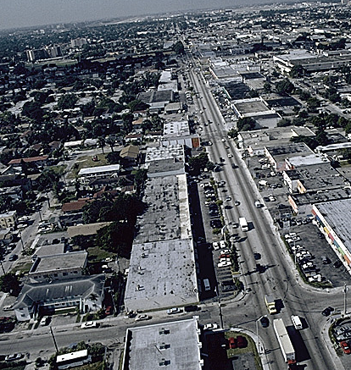
Common Pollutants in Urban Stormwater
Sediment & Trash
Fertilizers
Pesticides
Salts
Pathogens
Oil and Grease
Heavy Metals
Petroleum Products
Toxic Organics
Notes:
Urban areas are known to be significant sources of pollution.
Studies in the 1970s by EPA and others characterized the many types of pollutants and confirmed that they contributed to water quality degradation.
The variety of sources was extensive for each type of pollutant found in urban stormwater runoff.
Under authority of the federal Clean Water Act, EPA promulgated stormwater rules in 2 “Phases”: Phase I in 1990 and Phase II in 1999.
Nearly all States, including Oklahoma, were granted authority from EPA to manage the stormwater regulatory program.
Many aspects of compliance with the stormwater rules requires specialized skills in water quality.

Slide 9
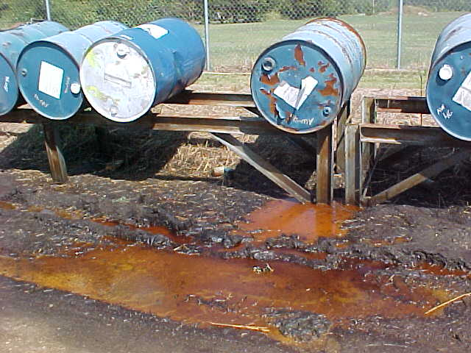
How To Know What You Are Facing
  Hundreds of thousands of chemicals are now on the market.
  Most do not have fully known human health or environmental effects.
  Many Illicit Discharges (IDs) in stormwater involve unknown substances.
  Many IDDE field test kits do not detect specific chemicals (e.g., pH, conductivity).
  Look for labels on containers; contact property owners.
  If you are uncertain about what the substance is, back off, protect area from others and contact local FD and HAZMAT.
Notes:
Compliance with stormwater rules is channeled mostly through a state’s “General Permit” process.
Oklahoma has 3 Stormwater General Permits: OKR04 for “small MS4s”, OKR05 for specific industrial activities, and OKR10 for active construction.
OKR04 permitted MS4s have the greatest problem with controlling pollution because many kinds of pollutants can be found in an MS4’s urban area.
When a pollution event is discovered by or reported to the MS4, often the type of pollutant is not immediately known.
The investigator may find unmarked containers or even no visible source, or there may be evidence of toxicity, such as a fish kill, that has no observable cause.
Each MS4 must have very specific and effective investigative procedures for tracking pollution sources.
MS4s are required to collect field data from illicit discharge sites in order to support enforcement of local ordinances for control and cleanup.

Slide 10

  Third-Party Pollution Reporting:
    Citizen complaints, concerns (letters, email, phone).
    MS4 reporting hotline (email, phone).
    Local businesses, schools, clubs, organizations.
    Local, state or federal environmental agencies.
    News services, reporters.
    City councils, county commissions – agenda items.
    City contractors at outdoor projects.
  Have a formal system for logging pollution reports.
Types of Pollution Discovery
Notes:
There are 2 ways in which an MS4 will learn about a local stormwater pollution problem: those reported by an outside third party and those discovered by the MS4 employees themselves.
Third party discoveries are normally from citizens and local businesses who observe some type of pollutant (e.g., discolored water) or its effect (e.g., a fish kill).
The OKR04 permit requires that the MS4 have formal procedures for receiving third party “illicit discharge” information and for investigating the potential pollution event.
Third party reporting sources will include citizens and businesses, local schools, news media, clubs or organizations, state or federal agencies, city contractors and elected officials.
Many MS4s have established a special stormwater pollution hotline for reporting potential stormwater pollution problems.

Slide 11
  Pollution Found by MS4 Personnel:
    Dry Weather Field Screen (DWFS) inspections.
    Other stormwater permit required inspections.
    Public works crews at or en-route to job sites.
    Police and Fire Dept. on-scene observations.
    Parks & Recreation workers.
    City crews finding spills or releases.
    Construction site inspections.
  Have a formal system for tracking pollution responses.
Types of Pollution Discovery
Notes:
MS4s should train field crews in other Departments to look for pollution in the stormwater collection system (the MS4) while on the job and on how to file a report on the incident.
Stormwater program staff will likely be the most frequent source of illicit discharge reporting, either through DWFS inspections or other MS4 inspections.
Police officers and Firefighters are also likely to observe potential pollutant discharges; all should be trained to report incidents of illicit discharges to the stormwater program staff.
Public Works Department field crews should also be trained to spot and report potential illicit discharges. These include water and sewer, parks and construction inspectors.
The MS4 must implement a formal incident tracking system that covers initial reporting to completion of cleanup and incident closeout.

Slide 12
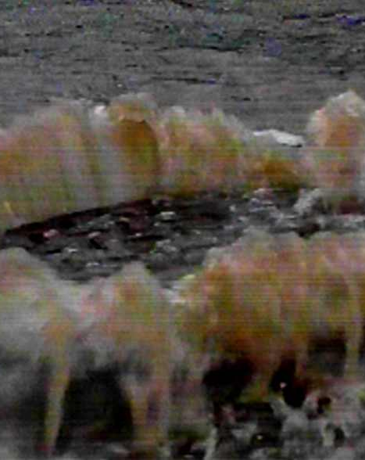
Common Places To Find Pollution
  Construction sites, storage areas.
  Drainage ditches, open channels, creeks.
  Manholes, often in remote locations.
  Abandoned buildings and foundations.
  Dilapidated homes, buildings or structures.
Isolated back lots of industrial areas.
Storage and loading areas at businesses.
Drop inlets and curb cuts in remote areas.
Pipes and trickle channels into creeks.
Alleys and lots with dumpsters and trash bins.
Notes:
If you think about it, anyone wanting to make an illegal discharge will do so in a remote location that prevents easy observation.
Such remote areas include: old manholes, drainage ditches, open channels and creeks, especially those behind isolated or abandoned buildings or structures or in areas of dense vegetation.
Field crews should also look for pipes that can discharge to the MS4 itself or to local creeks or ponds.
Even small pipes or small drainage channels that are not flowing at time of discovery have the potential to be illicit discharges, and they must be tracked back to the source.
Dumpsters and trash bins behind buildings or in alleys can be significant sources of pollutants from illegal dumping or from leaking containers.

Slide 13
Formal System for Tracking MS4 Actions
  MS4s must implement a program for “Illicit Discharge Detection and Elimination” (IDDE).
  Records must be kept of all actions taken regarding the IDDE program, and to report progress in the MS4’s Annual Report to DEQ.
  OKR04 does not specify exact procedures for running the IDDE program; OKR04 is flexible but the program must be effective.
  IDDE Tracking System can be all electronic, all paper, or a combination of both.
  Tracking must cover initial report to final actions.
Notes:
Both the 2015 OKR04 Part IV.C.3.a(2) and the 2021 OKR04 Part V.C.3 require the MS4 to implement a comprehensive Illicit Discharge Detection and Elimination (IDDE) program.
However, neither of these Parts specifies exact procedures for running the IDDE program; OKR04 is flexible, but the program must be effective.
The MS4 must document all actions taken, from initial discovery of an event to inspection, enforcement and cleanup.
The IDDE information must be reported in the MS4’s Annual Report to DEQ.
OKR04 does not require computer software; paper files can be used. However, software-based systems can have many incident tracking and recordkeeping benefits.

Slide 14
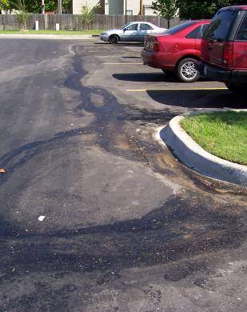
Common Finds For Field Crews To Report
  Suspicious flows in culverts, ditches, pipes.
  Unusual odors or discolored water or soil near creeks.
  Trash, debris, floating mats of algae or scum in creeks.
  Dead animals, batteries, containers or boxes in creeks.
Piles of discolored soils or dumped waste piles.
Fish kills or other signs of stressed organisms.
Log jams, leaves or lawn clippings in creek.
Sediment or chemical runoff from sites.
Ground soaked with oil, paints or chemicals.
Notes:
This slide suggests a number of physical conditions at inspection sites that might indicate the presence or impacts from a stormwater pollution event.
Field forms can be prepared in advance that includes these types of observations. Note that none of these rely upon actual chemical testing.
OKR04 requires that DWFS and source tracking inspections rely upon both visual observations and the use of simple field test kits.
Field forms can be created so that most entries are check boxes to record the severity of observed or measured problem indicators.
Chemistry-based field kits need a higher level of training and experience for use and for interpreting test results.
INCOG provides training on conducting field inspections and use of test kits, and more GCSA training is planned for the near future.

Slide 15
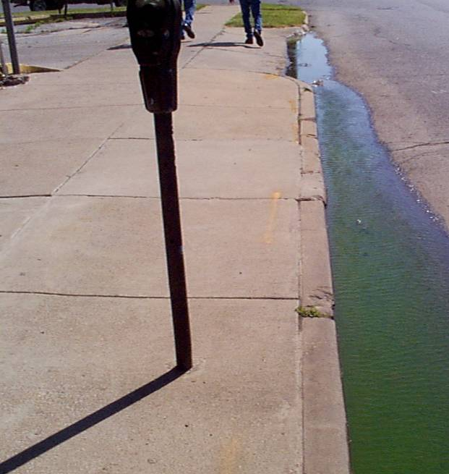
Problems With Identifying Pollution
  Most reports of Illicit Discharges (IDs) in your MS4 will involve unknown substances.
  Many IDDE field test kits do not detect specific chemicals.
  Look for labels on containers or property signs.
  Contact property owners or other suspected polluters.
  If you are uncertain about what the substance is, back off, protect area from others, and contact local Fire Department or HAZMAT.
Notes:
While discovering a potential pollution problem may be fairly easy to do, it is often difficult to know just what the pollutant is and thus know the potential danger.
Most chemicals in illicit discharges are unknown substances that may appear harmless, but never make assumptions of no harm without proper testing.
Most common field test kits do not identify specific chemicals; these include test kits for pH, conductivity, temperature, dissolved oxygen, turbidity, dissolved solids, etc.
However, there are chemical-specific field test kits that do measure specific chemicals such as chlorine residual, phosphorus, nitrogen, cadmium or a specific pesticide like Diazinon.
In lieu of chemical testing, illicit discharges can often be identified by reading the labels on their containers or by asking the facility owners.
No MS4 inspector should ever approach or handle unknown chemicals; always contact your local Fire Department or HAZMAT.

Slide 16
  Look for and (carefully and safely) investigate:
      Containers and labels;
      Sources such as batteries, cans, boxes, etc.
      Pipes, culverts, open channels with flow.
      Discolored water, soil, stains on concrete.
      Dead animals, dead vegetation.
      Floatables (trash, debris, vegetation, etc.).
  Note offensive or unusual odors (decay, sewage).
  Note water opacity (clarity) and color.
First Step: Make a Visual Inspection
Notes:
Begin the site inspection by making visual observations and entering the results on a field form. Be prepared to make form updates frequently with your field experience.
Not only look for the possible chemical discharge itself, but also its affect on the environment such as fish kills or dead vegetation.
Also look at all possible points of entry, such as culverts, pipes and channels, even if not flowing.
Note the labels and markings on any discarded containers or boxes at the inspection site.
Other signs of the presence of illicit discharges include odors, trash and discolored water or soil or stains on concrete culverts.
Often these visual observations are all you will need to locate the source of the illicit discharge.

Slide 17
  Many simple field test kits will look for characteristics, not specific chemicals.
      Dissolved oxygen, pH.
      Conductivity (salts, dissolved solids).
  Foremost is SAFETY. If the material is unknown, contact your local Fire Department or HAZMAT.
  Never attempt to handle unknown substances without adequate training in handling hazardous materials.
  HAZMAT crews will have field kits, or lab analysis may be needed to get positive identification.
How Can You Identify What You Find?
Notes:
Finding an unknown substance or evidence of past illicit discharge requires identifying the substance and its source.
The first step is to see if identification can come from marked containers or by talking to the property owner.
If there is no way to determine what the illicit discharge substance is, use of a few simple field test kits can help identify certain chemical characteristics, such as conductivity or pH of the stream water impacted by the discharge.
Safety is paramount: always contact your local Fire Department or HAZMAT if you are unable to determine the substance or feel there is a public safety hazard.

Slide 18
Recurring Problems DEQ Finds In MCM-6 Inspections of MS4 Facilities
Structural BMPs are not being used:
  On City Maintenance Projects,
  City Construction Projects with and w/o OKR10 permits,
  Salt/Sand/ Asphalt Mix stockpiles.
Street Sweepers washing out into storm drains or directly into streams.
Dewatering of spoils in an area where runoff is not contained.
Annual City facility inspections not being thorough; inspectors need to walk their facilities completely.
Barrels of liquids not being protected from run-on and run-off.
Notes:
Over the past several years, DEQ staff have visited many MS4 facilities while performing the DEQ Performance Evaluation (audit) inspection for OKR04 compliance.
This slide lists the most common deficiencies DEQ finds at MS4 facilities falling under the MCM-6 Good Housekeeping requirement.
There is a significant increase in concern from DEQ over MS4 compliance regarding MCM-6, so these deficiencies need to be addressed by all MS4s.
DEQ uses its own field form for conducting their Audit inspections which is available to MS4s through DEQ or INCOG as a GCSA Member.
In addition, each MS4 can prepare their own MCM-6 field inspection form, just be certain that it is comprehensive and in a usable format.
INCOG will also help its GCSA Members with updating their facility inspection forms.

Slide 19



End of Module 1 on
MCM-6 Introduction
Vernon Seaman
Manager, Envir. And Energy Planning
INCOG
Two West 2nd Street, Ste 800
Tulsa, OK 74103
(918) 579-9451
vseaman@incog.org
Notes:
This concludes the first of 6 annotated PowerPoint (aPPT) Modules for local MCM-6 training.
Training Presentations 2 through 5 cover the training subjects listed in the OKR04 permit.
The final Presentation covers additional facilities that may be owned by GCSA Members.
INCOG expects to be able to return to physical half-day GCSA Employee Training Workshops in the second half of 2021.
In this interim period, INCOG will continue to prepare annotated PowerPoints (aPPTs) for local staff training use.

